Slide 1
The Operating Efficiency of Public and Private High Schools in Xindian District of New Taipei City: Three Models in DEA

Slide 2
1. INTRODUCTION

Slide 3
INTRODUCTION (1/2)
Education reforms and analysis of school competitiveness are popular issues for government agencies, academics, and industries.

Slide 4
INTRODUCTION (2/2)
This study uses three analytical models to solve competitiveness analysis of public and private high schools Problem with quantitative analysis. These three models are:
data envelopment analysis (DEA),
the cross-efficiency model,
the categorical variable model.
We hope that the results of this analysis can serve as a reference for schools in setting up performance improvement strategies and for government agencies in formulating related policies and measures.

Slide 5
2. LITERATURE REVIEWS

Slide 6
LITERATURE REVIEWS (1/3)
Past studies on the education industry were mainly conducted from the perspective of school marketing, with enhancement of organizational efficiency being the main objective. (Kotler and Fox (1994) ; Connor (1999) )
Hence, Hanushek, and Woessmann (2009) assessed school operational performance by measuring student achievements. Notably, the above mentioned studies used students’ results to measure the performance of public schools and were unable to objectively reflect the operational efficiencies of these schools.

Slide 7
LITERATURE REVIEWS (2/3)
The DEA model, which has been widely used in many areas, since it was first developed by Charnes, Cooper and Rhodes (1978). DEA is characterized by its concept of relative efficiency and its capacity for handling inputs and outputs from different units.
Duncombe et al. (1997), Hoxby (2000), Grosskopf et al. (2001), Bukowska and Siwińska-Gorzelak (2011) have applied DEA to measure the operational efficiency of schools.

Slide 8
LITERATURE REVIEWS (3/3)
DEA has been applied by many scholars to measure the operational efficiency in schools, and these studies have focused on analyzing the competitiveness of universities, with some subsequent focus on the competitiveness of high schools, vocational schools, junior high schools. For example, Lee (2009) and Huang (2012) studied the operational efficiency of senior vocational schools.
In addition to using the standard DEA model for estimating the operational efficiency, this study also employs the cross-efficiency model to objectively assess each DMU and differentiate among genuinely efficient DMUs. We then incorporate considerations for group characteristics by using categorical variable model to estimate school operational efficiency.

Slide 9
3. PROPOSED MODEL

Slide 10
3.1 Data Methodology (1/2)
(1)
Model Explanation: CCR Model
The first DEA model, proposed by Charmes et al.(1978), is also known as CCR, which assumes the DMUs to be assessed and operated within a technology where efficient production is characterized by constant returns to scale(CRS).

Slide 11

3.1 Data Methodology (2/2)
Model Explanation: BCC model
This model differs from the basic CCR model only in that it clues in the previous formulation the convexity constraint :
In summary, the following equation can be obtained:
Technical Efficiency = Pure Technical Efficiency × Scale Efficiency
$\sum_{i=1}^{n}{λ_{j}=1}$

Slide 12
3.2 DEA cross-efficiency evaluation
The second cross-efficiency model, proposed by Sexton et al. (1986). The main idea of cross evaluation is to use DEA in a peer-evaluation called a self-evaluation mode.

Slide 13
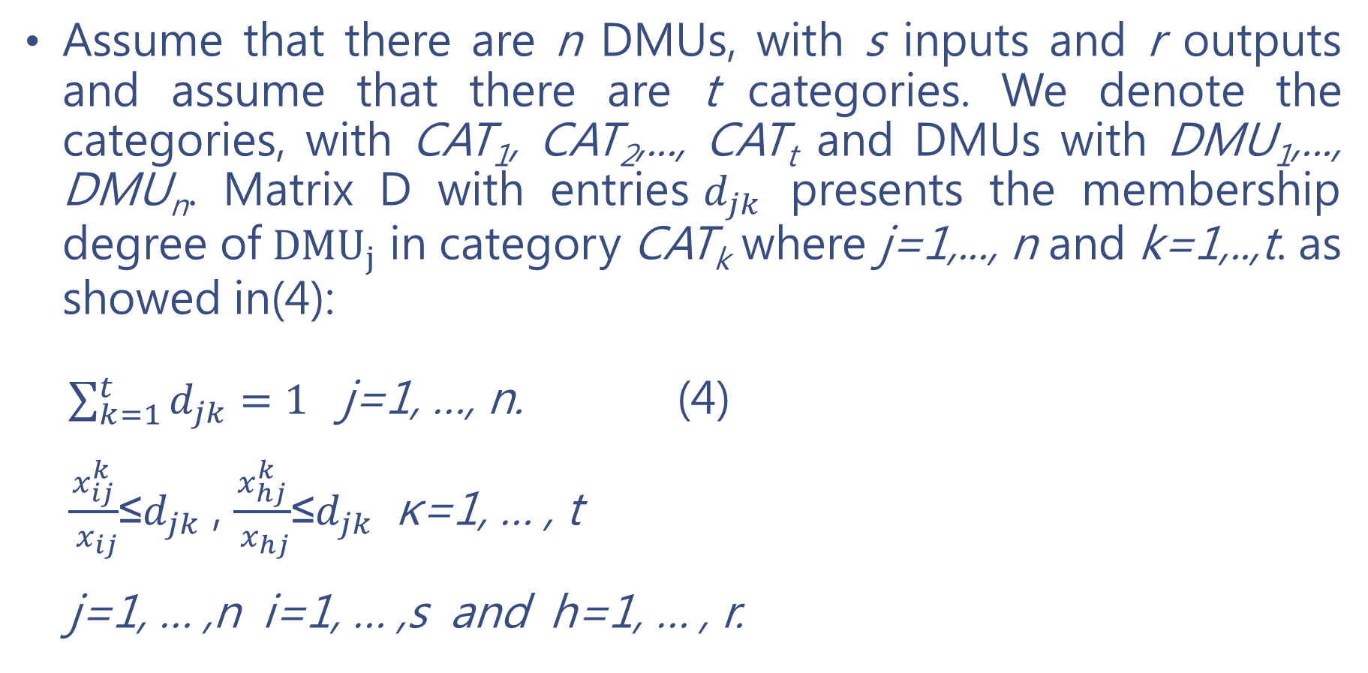
3.3 Categorical variable evaluation
Assume that there are n DMUs, with s inputs and r outputs and assume that there are t categories. We denote the categories, with CAT₁, CAT₂,..., CAT_{t} and DMUs with DMU₁,..., DMU_{n}. Matrix D with entries${ d}_{jk}$ presents the membership degree of ${DMU}_{j}$ in category CAT_{k} where j=1,..., n and k=1,..,t. as showed in(4):
$\sum_{k=1}^{t}{d_{jk}=1}$ j=1, …, n. (4)
$\frac{x_{ij}^{k}}{ x_{ij}}$≤$d_{jk}$ , $\frac{x_{hj}^{k}}{ x_{hj}}$≤$d_{jk}$ κ=1, … , t
j=1, … ,n i=1, … ,s and h=1, … , r.

Slide 14
3.4 Research Subjects and Variables (1/2)
3.4.1 Research Subjects
NO | School name | Category | Group
1 | Juang Jing Vocational High School | Vocational High School | 1
2 | Kai Ming Senior Technical and Commercial Vocational School | Vocational High School | 1
3 | Nan Chiang Industrial and Commercial Senior High School | Vocational High School | 1
4 | Neng Ren Home Economic And Commercial Vocational High School | Vocational High School | 1
5 | New Taipei Municipal Hsin Tien Senior High school | Senior High School | 2
6 | New Taipei Municipal An Kang High School | complete school | 2
7 | Our Lady Of Providence Girls' High School | Senior High School | 2
8 | Chi Jen Senior High School | Senior High School | 2

Slide 15
3.4 Research Subjects and Variables (2/2)
Pearson’s correlation analysis was used for preliminary analysis of the level of correlation between the inputs and outputs .
 | number of subject groups | number of teachers | staff | namely the number of school students | number of graduates | classes
number of subject groups | 1 | 0.155 | 0.088 | 0.691 | 0.631 | 0.686
number of teachers | 0.155 | 1 | 0.335 | 0.007 | 0.101 | 0.029
staff | 0.089 | 0.335 | 1 | 0.495 | 0.354 | 0.504
namely the number of school students | 0.691 | 0.007 | 0.496 | 1 | 0.914 | 0.993
number of graduates | 0.631 | 0.101 | 0.354 | 0.914 | 1 | 0.916
classes | 0.686 | 0.029 | 0.504 | 0.992 | 0.916 | 1

Slide 16
4. EMPIRICAL RESULTS

Slide 17
4.1 DEA Analysis
Referring to the table below, it indicates that the efficiency value of vocational schools is greater than that of high schools under the DEA model, as high schools had almost no efficiency. The total efficiency of vocational schools was nearly 1 (TE = 1) in each of the six years.
DMU | 2007 | 2008 | 2009 | 2010 | 2011 | 2012 | Average
1 | 1 | 1 | 1 | 1 | 1 | 0.835 | 0.972
2 | 0.675 | 0.871 | 1 | 1 | 1 | 1 | 0.924
3 | 1 | 1 | 1 | 0.962 | 0.993 | 0.896 | 0.975
4 | 0.992 | 1 | 0.952 | 1 | 1 | 0.848 | 0.965
5 | 1 | 0.729 | 0.748 | 0.767 | 0.751 | 0.736 | 0.788
6 | 0.360 | 0.286 | 0.274 | 0.299 | 0.342 | 0.385 | 0.325
7 | 0.542 | 0.524 | 0.579 | 0.521 | 0.527 | 0.470 | 0.527
8 | 0.911 | 1 | 0.522 | 0.591 | 0.621 | 0.584 | 0.705

Slide 18
4.2 Cross-efficiency Analysis
Vocational schools were observed to be generally more efficient than senior high schools. Under the government free tuition policy, vocational high schools received more educational subsidies and were able to attract more students, thereby significantly improving their operations.
DMU | 2007 | 2008 | 2009 | 2010 | 2011 | 2012 | Average
1 | 0.599 | 0.849 | 0.744 | 0.743 | 0.726 | 0.638 | 0.717
2 | 0.448 | 0.826 | 0.972 | 0.964 | 0.959 | 0.977 | 0.858
3 | 0.483 | 0.912 | 0.887 | 0.854 | 0.835 | 0.745 | 0.786
4 | 0.683 | 0.883 | 0.822 | 0.948 | 0.795 | 0.674 | 0.801
5 | 0.830 | 0.630 | 0.637 | 0.654 | 0.638 | 0.619 | 0.668
6 | 0.236 | 0.178 | 0.180 | 0.192 | 0.226 | 0.246 | 0.210
7 | 0.422 | 0.413 | 0.459 | 0.391 | 0.382 | 0.364 | 0.405
8 | 0.627 | 0.599 | 0.407 | 0.446 | 0.486 | 0.478 | 0.507

Slide 19
4.3 Categorical Variable Analysis
As shown by the table below, Group 1 performed better than Group 2 under this analytical model, indicating that the efficiencies of vocational schools were generally better than those of private high schools. Indeed, vocational high schools received more educational subsidies under the government free tuition policy and were therefore able to attract more students, thereby significantly improving their operations.
DMU | 2007 | 2008 | 2009 | 2010 | 2011 | 2012 | Average | Group
1 | 1 | 1 | 1 | 1 | 1 | 0.834 | 0.972 | 1
2 | 0.675 | 0.871 | 1 | 1 | 1 | 1 | 0.924 | 1
3 | 1 | 1 | 1 | 0.962 | 0.993 | 0.896 | 0.975 | 1
4 | 0.991 | 1 | 0.952 | 1 | 1 | 0.847 | 0.965 | 1
5 | 0.780 | 0.793 | 0.793 | 0.812 | 0.832 | 0.775 | 0.812 | 2
6 | 0.187 | 0.285 | 0.275 | 0.300 | 0.342 | 0.384 | 0.295 | 2
7 | 0.648 | 0.634 | 0.697 | 0.607 | 0.598 | 0.559 | 0.624 | 2
8 | 1 | 1 | 0.614 | 0.647 | 0.712 | 0.719 | 0.782 | 2

Slide 20
4.4 Integrative Analysis of the Three Models
This study further analyzed and tested the three analysis models.
The P-value of the test result was 3.0044×10-5, that is, less than the significance level of 0.05, the null hypothesis can be rejected.
The categorical variable model can better estimate operational efficiency for these senior high schools and vocational schools in Xindian District of New Taipei City than that those of other two models.

Slide 21
5. CONCLUSION

Slide 22
Conclusions
The efficiency values provided by the standard DEA analysis are the highest and mostly 1, which is a result of not consider characteristics and peer issues.
Using the cross-efficiency measure, the efficiency values of all schools were below one. It takes into consideration of peers and time factors relatively in the cross-efficiency model, and most efficiency values were relatively lower among all three models.
As to categorical variable DEA model which considers group attributes, characteristics, and time. It, indeed, generates differences in efficiency values, and the efficiency comparison based on the type of characteristics differentiates among inefficient schools, objectively .

